Slide 1
Lecture 9. Public Key Cryptography and RSA
CSE 1204 Applied Cryptography
Lectures by Zhaxalykov T.M.

Slide 2
Agenda
Introduction to Public Key Cryptography
Mathematical Foundations
The RSA Algorithm
RSA Security Analysis
RSA Signatures
Practical RSA Implementation

Slide 3
1. Introduction to Public Key Cryptography
1.1 The Key Distribution Problem
1.2 Public Key Cryptography Concept
1.3 Public Key Operations
1.4 Advantages and Limitations

Slide 4
1. Introduction to Public Key Cryptography
Public key cryptography, invented independently by Whitfield Diffie and Martin Hellman (1976) and by RSA (1977), revolutionized cryptography by solving the key distribution problem that plagued symmetric systems.

Slide 5
1.1 The Key Distribution Problem
In symmetric cryptography, Alice and Bob must share a secret key k before communicating. This creates fundamental challenges:
Key Exchange: How do Alice and Bob agree on k over an insecure channel? Meeting in person is impractical.
Scalability: For n users to communicate pairwise, need n(n-1)/2 different keys. For 1000 users: ~500,000 keys.
No Non-Repudiation: Both parties know k. Alice cannot prove to third party that Bob sent message—she could have created it herself.

Slide 6
Example 1.1: Internet Communication Challenge
When you connect to https://example.com, you've never communicated with that server before. With symmetric crypto only, you'd need to somehow establish a shared secret before encrypting. This is impossible at scale—imagine exchanging physical keys with every website you visit!

Slide 7
1.2 Public Key Cryptography Concept
Definition 1.1 (Public Key Cryptosystem): A public key cryptosystem uses two different keys: (1) Public key: published openly, used for encryption or signature verification. (2) Private key: kept secret, used for decryption or signing. Mathematical relationship ensures messages encrypted with public key can only be decrypted with corresponding private key.

Slide 8
1.2 Public Key Cryptography Concept
Key Properties:
Asymmetry: Different keys for encryption and decryption
Public Distribution: Public key can be freely distributed without compromising security
One-Way Function: Easy to encrypt with public key, hard to decrypt without private key

Slide 9
1.3 Public Key Operations
Encryption/Decryption:
Alice wants to send message to Bob:
1. Alice obtains Bob's public key PK_Bob
2. Alice computes C = Encrypt(PK_Bob, M)
3. Bob decrypts M = Decrypt(SK_Bob, C)
Only Bob (with SK_Bob) can decrypt C

Slide 10
1.3 Public Key Operations
Digital Signatures:
Alice wants to sign message:
1. Alice computes S = Sign(SK_Alice, M)
2. Anyone can verify: Verify(PK_Alice, M, S) = valid/invalid
Only Alice can create valid signature (proves authenticity)

Slide 11
1.4 Advantages and Limitations
Advantages:
No key exchange needed: public keys distributed openly
Scalability: n users need only n key pairs (not n²/2 shared keys)
Non-repudiation: digital signatures prove authorship
Foundation for PKI (Public Key Infrastructure)
Limitations:
Performance: 100-1000× slower than symmetric crypto
Message size: can only encrypt small messages (typically < key size)
Key distribution: still need to verify public key authenticity (PKI solves this)
Hybrid Approach: In practice, use public key crypto to exchange symmetric key, then use symmetric crypto for bulk data. This combines benefits of both: public key for key exchange, symmetric for speed.

Slide 12


Slide 13
2. Mathematical Foundations
2.1 Modular Arithmetic
2.2 Greatest Common Divisor and Coprimality
2.3 Euler's Totient Function
2.4 Euler's Theorem and Fermat's Little Theorem
2.5 Modular Multiplicative Inverse

Slide 14
2. Mathematical Foundations
RSA security relies on number theory. We review essential mathematical concepts.

Slide 15
2.1 Modular Arithmetic
Definition 2.1 (Modular Congruence): a ≡ b (mod n) means n divides (a - b), equivalently a and b have same remainder when divided by n.

Slide 16
Example 2.1: Modular Arithmetic
17 ≡ 5 (mod 12) because 17 - 5 = 12 is divisible by 12
Clock arithmetic: 15 o'clock ≡ 3 o'clock (mod 12)
25 ≡ 4 (mod 7) because 25 mod 7 = 4
Properties:
Addition: (a + b) mod n = ((a mod n) + (b mod n)) mod n
Multiplication: (a × b) mod n = ((a mod n) × (b mod n)) mod n
Exponentiation: a^k mod n can be computed efficiently

Slide 17
2.2 Greatest Common Divisor and Coprimality
Definition 2.2 (GCD): gcd(a, b) is the largest integer dividing both a and b.
Definition 2.3 (Coprime): a and b are coprime (or relatively prime) if gcd(a, b) = 1.

Slide 18
Example 2.2: GCD Computation
gcd(15, 28) = 1 (coprime)
gcd(18, 24) = 6 (not coprime)
Use Euclidean algorithm for efficient computation

Slide 19
2.3 Euler's Totient Function
Definition 2.4 (Euler's Totient Function): φ(n) counts integers from 1 to n that are coprime with n.

Slide 20
Example 2.3: Computing φ(n)
φ(8) = 4 because {1, 3, 5, 7} are coprime with 8
φ(9) = 6 because {1, 2, 4, 5, 7, 8} are coprime with 9
φ(7) = 6 (for prime p: φ(p) = p - 1)

Slide 21
Example 2.3: Computing φ(n)
Key Property for RSA:
Theorem 2.1: If p and q are distinct primes, then φ(pq) = (p-1)(q-1).
Proof: Among integers 1 to pq, those not coprime with pq are multiples of p or q. There are q multiples of p and p multiples of q (including pq). By inclusion-exclusion: φ(pq) = pq - p - q + 1 = (p-1)(q-1).

Slide 22
Example 2.4: RSA Application
p = 61, q = 53
n = pq = 3233
φ(n) = (61-1)(53-1) = 60 × 52 = 3120

Slide 23
2.4 Euler's Theorem and Fermat's Little Theorem
Theorem 2.2 (Euler's Theorem): If gcd(a, n) = 1, then a^φ(n) ≡ 1 (mod n).
This is the mathematical foundation of RSA decryption.

Slide 24
Example 2.5: Euler's Theorem
n = 10, φ(10) = 4, a = 3 (coprime with 10)
3^4 mod 10 = 81 mod 10 = 1 ✓
n = 21, φ(21) = 12, a = 5
5^12 mod 21 = 1 ✓

Slide 25
Example 2.5: Euler's Theorem
Corollary 2.1 (Fermat's Little Theorem): If p is prime and gcd(a, p) = 1, then a^(p-1) ≡ 1 (mod p).
Special case of Euler's Theorem since φ(p) = p - 1 for primes.

Slide 26
2.5 Modular Multiplicative Inverse
Definition 2.5 (Modular Inverse): The modular multiplicative inverse of a modulo n is an integer x such that ax ≡ 1 (mod n). Denoted a^(-1) mod n.
Theorem 2.3: a has modular inverse mod n if and only if gcd(a, n) = 1.
Computed using Extended Euclidean Algorithm.

Slide 27
Example 2.6: Modular Inverse
Find 7^(-1) mod 26:
7 × 15 = 105 = 4 × 26 + 1 ≡ 1 (mod 26)
Therefore 7^(-1) ≡ 15 (mod 26)
Verify: 7 × 15 mod 26 = 105 mod 26 = 1 ✓

Slide 28
3. The RSA Algorithm
3.1 Key Generation
3.2 Encryption
3.3 Decryption
3.4 Why RSA Works: Correctness Proof

Slide 29
3. The RSA Algorithm
RSA, invented by Rivest, Shamir, and Adleman in 1977, was the first practical public key cryptosystem.

Slide 30
3.1 Key Generation
Algorithm:
Select two large distinct primes p and q (typically 1024+ bits each)
Compute n = pq (the modulus, typically 2048-4096 bits)
Compute φ(n) = (p-1)(q-1)
Choose public exponent e: 1 < e < φ(n), gcd(e, φ(n)) = 1. Common choice: e = 65537 = 2^16 + 1
Compute private exponent d = e^(-1) mod φ(n) using Extended Euclidean Algorithm
Public key: (n, e)
Private key: (n, d). Also keep p, q, φ(n) secret (usually discarded or stored separately)

Slide 31
Example 3.1: Small RSA Key Generation
Step 1: Choose primes p = 61, q = 53
Step 2: n = 61 × 53 = 3233
Step 3: φ(n) = 60 × 52 = 3120
Step 4: Choose e = 17 (coprime with 3120)
Step 5: Compute d = 17^(-1) mod 3120 = 2753
Verify: 17 × 2753 mod 3120 = 46801 mod 3120 = 1 ✓
Public key: (3233, 17)
Private key: (3233, 2753)

Slide 32
3.2 Encryption
To encrypt message M (where 0 ≤ M < n) using public key (n, e): C = M^e mod n

Slide 33
Example 3.2: RSA Encryption
Message: M = 123
Public key: (n = 3233, e = 17)
Encryption: C = 123^17 mod 3233
Using repeated squaring:
123^1 mod 3233 = 123
123^2 mod 3233 = 15129 mod 3233 = 2286
123^4 mod 3233 = 2286^2 mod 3233 = 2033
123^16 mod 3233 = 2033^4 mod 3233 = 2761
123^17 = 123^16 × 123^1 mod 3233 = 2761 × 123 mod 3233 = 855
Ciphertext: C = 855

Slide 34
3.3 Decryption
To decrypt ciphertext C using private key (n, d): M = C^d mod n

Slide 35
Example 3.3: RSA Decryption
Ciphertext: C = 855
Private key: (n = 3233, d = 2753)
Decryption: M = 855^2753 mod 3233 = 123 ✓
Message recovered: M = 123

Slide 36
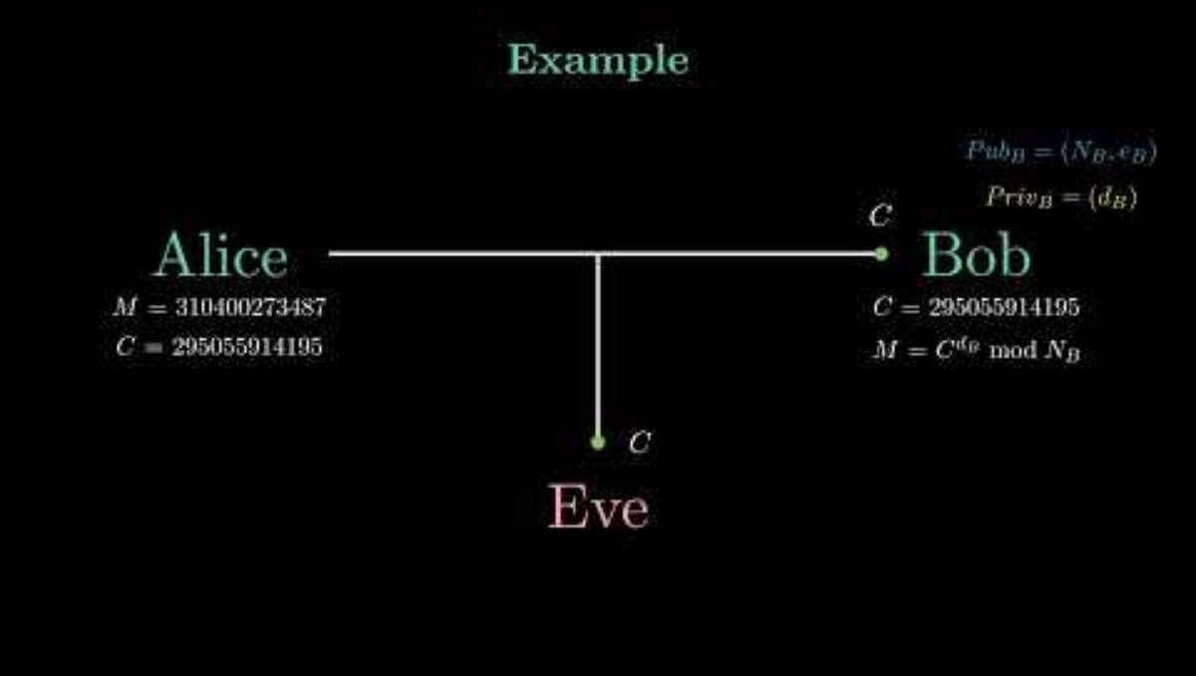

Slide 37
4. RSA Security Analysis
4.1 Security Foundation
4.2 Key Size Recommendations
4.3 Textbook RSA Vulnerabilities
4.4 Timing Attacks

Slide 38
4.1 Security Foundation
RSA security relies on computational hardness assumptions:
Integer Factorization Problem: Given n = pq, finding p and q is believed computationally infeasible for large n.
If adversary factors n, they compute φ(n) = (p-1)(q-1) and recover d = e^(-1) mod φ(n), completely breaking RSA.
Best Known Algorithm: General Number Field Sieve (GNFS)
Complexity: O(exp((log n)^(1/3) × (log log n)^(2/3)))
Sub-exponential but super-polynomial—very slow for large n

Slide 39
Example 4.1: Factorization Records
1994: RSA-129 (426 bits) factored after 8 months (distributed computing)
2009: RSA-768 (768 bits) factored after 2 years
2020: RSA-250 (829 bits) factored after several months
RSA-1024: Estimated centuries with current technology
RSA-2048: Infeasible for foreseeable future

Slide 40
4.2 Key Size Recommendations
Key Size | Security Level (Symmetric Equivalent) | Status & Recommendation
512 bits | 56-bit | BROKEN (Factored in 1999; do not use)
1024 bits | 80-bit | DEPRECATED (Factoring likely possible by 2030)
2048 bits | 112-bit | MINIMUM (Standard for current use until ~2030)
3072 bits | 128-bit | RECOMMENDED (Standard for long-term security)
4096 bits | 140-bit | HIGH SECURITY (Maximum size for typical applications)

Slide 41
4.3 Textbook RSA Vulnerabilities
Textbook RSA' (unpadded) has serious vulnerabilities:
Deterministic: Same plaintext always produces same ciphertext. Adversary can recognize known messages.
Malleability: Given C = M^e, adversary can compute C' = (sC)^e = (sM)^e for any s, creating valid encryption of sM without knowing M.

Slide 42
Example 4.2: Malleability Attack
Encrypted salary: C = Encrypt('$50000')
Adversary computes: C' = C × 2^e mod n
Decrypts to: '$100000' (doubled salary!)
Small Message Space: If M is small and e = 3, then M^3 < n, so C = M^3 (no modular reduction). Adversary computes ∛C to recover M.
Solution: Never use textbook RSA. Always use proper padding schemes (PKCS#1 v1.5 or OAEP).

Slide 43
4.4 Timing Attacks
RSA implementations vulnerable to timing attacks where decryption time depends on private key bits. Adversary measures timing to recover d.
Defense: Use constant-time implementations or RSA-CRT (Chinese Remainder Theorem) optimization with blinding.

Slide 44
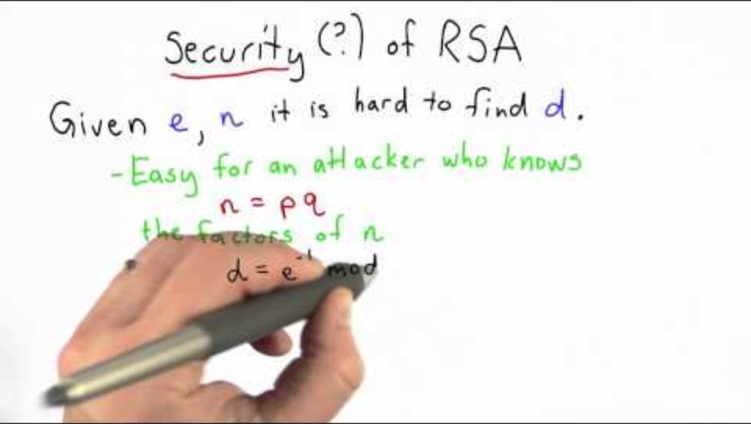

Slide 45
5. RSA Signatures
5.1 Basic RSA Signature Scheme
5.2 Hash-and-Sign
5.3 RSA-PSS (Probabilistic Signature Scheme)

Slide 46
5. RSA Signatures
RSA supports digital signatures by reversing roles of public and private keys.

Slide 47
5.1 Basic RSA Signature Scheme
Signing (with private key (n, d)):
S = M^d mod n
Verification (with public key (n, e)):
M' = S^e mod n
Accept if M' = M

Slide 48
Example 5.1: RSA Signature
Alice's keys: (n = 3233, e = 17, d = 2753)
Message: M = 123
Alice signs: S = 123^2753 mod 3233 = 2070
Alice publishes: (M = 123, S = 2070)
Bob verifies: M' = 2070^17 mod 3233 = 123
M' = M ✓ Signature valid!

Slide 49
5.2 Hash-and-Sign
In practice, sign hash of message rather than message itself:
S = H(M)^d mod n
Verify: H(M)' = S^e mod n, check H(M)' = H(M)
Advantages:
Can sign arbitrarily large messages (hash is fixed size)
Performance: hash much faster than RSA on large data
Security: collision resistance prevents signature forgery

Slide 50
5.3 RSA-PSS (Probabilistic Signature Scheme)
RSA-PSS is the recommended RSA signature scheme (RSA PKCS#1 v2.1).
Key Features:
Probabilistic: uses random salt, different signatures for same message
Provable security: reduction to RSA problem
Tight security bounds
Used in modern standards: TLS 1.3, JOSE (JSON Web Signatures).

Slide 51


Slide 52
6. Practical RSA Implementation
6.1 Padding Schemes
6.2 Prime Generation
6.3 Performance Optimization
6.4 Hybrid Encryption

Slide 53
6.1 Padding Schemes
PKCS#1 v1.5: Older standard, still widely used but vulnerable to chosen-ciphertext attacks (Bleichenbacher's attack).
OAEP (Optimal Asymmetric Encryption Padding): Modern standard with provable security. Uses hash function and mask generation function.
Recommendation: Use OAEP for encryption, RSA-PSS for signatures.

Slide 54
6.2 Prime Generation
Generating large primes for RSA:
Generate random odd number of required size
Test primality using Miller-Rabin test (probabilistic)
Repeat until prime found
Ensure p and q are sufficiently different (|p - q| large)
Prime Number Theorem: Approximately 1 in ln(n) random n-bit numbers is prime. For 1024-bit: ~1 in 710 candidates.

Slide 55
6.3 Performance Optimization
Chinese Remainder Theorem (CRT): Speeds up decryption by ~4×.
Instead of computing M = C^d mod n, compute:
M_p = C^(d mod (p-1)) mod p
M_q = C^(d mod (q-1)) mod q
Combine using CRT to get M
Small Public Exponent: Using e = 65537 makes encryption very fast (only 17 bits set). Decryption still slow.

Slide 56
6.4 Hybrid Encryption
Standard practice: use RSA to encrypt symmetric key, then use symmetric cipher for data.
1. Generate random AES key K
2. Encrypt K with RSA: C_K = RSA_Encrypt(PK, K)
3. Encrypt data with AES: C_data = AES_Encrypt(K, data)
4. Send (C_K, C_data)
This combines RSA's key distribution with AES's speed.

Slide 57
7. Conclusion
This lecture introduced public key cryptography through RSA. Key insights:
Public key cryptography solves key distribution problem with asymmetric keys
RSA security relies on hardness of integer factorization
Mathematical foundation: Euler's theorem, modular arithmetic, totient function
RSA provides both encryption and digital signatures
Modern RSA requires padding (OAEP, RSA-PSS) and large keys (2048+ bits)
Practical use: hybrid encryption combines RSA key exchange with symmetric data encryption

Slide 58
7.1 Looking Forward
Next Lecture (Week 10): Diffie-Hellman Key Exchange and Elliptic Curve Cryptography. We will study the Diffie-Hellman protocol, discrete logarithm problem, elliptic curves, ECDH, and ECDSA.

Slide 59
7.2 Preparation
Read Ferguson et al., Chapter 12: Diffie-Hellman, Chapter 13: Introduction to Elliptic Curves
Review: Discrete logarithm problem, cyclic groups
Lab: Implement RSA key generation and encryption
Quiz 3: Public key cryptography fundamentals

Slide 60
References
Bellare, M., & Rogaway, P. (1994). Optimal asymmetric encryption. In Advances in Cryptology—EUROCRYPT '94.
Diffie, W., & Hellman, M. (1976). New directions in cryptography. IEEE Transactions on Information Theory, 22(6), 644-654.
Ferguson, N., Schneier, B., & Kohno, T. (2010). Cryptography engineering: Design principles and practical applications. Wiley.
Rivest, R. L., Shamir, A., & Adleman, L. (1978). A method for obtaining digital signatures and public-key cryptosystems. Communications of the ACM, 21(2), 120-126.
RSA Laboratories. (2012). PKCS #1 v2.2: RSA Cryptography Standard.

